Slide 1
Network Design and Architecture Group 9 (Aziz, Kim, Samvav)

Slide 2
Introduction: Network Design and Architecture
This report outlines the design and implementation of a secure, efficient, and scalable network for a client relocating to a new office. The network is tailored to meet the needs of key departments, including Management, Study, Production, and Support, while focusing on performance, security, and future scalability.
Key features include:
VLAN Segmentation:
Departments are isolated for improved security and reduced broadcast traffic.
Inter-VLAN Routing:
Layer 3 switches enable controlled communication between VLANs, optimizing traffic and reducing hardware costs.
IP Addressing & Subnetting:
A structured IP scheme with centralized DHCP ensures easy management and organization.
Security Measures:
The network is protected using ACLs, RADIUS-based authentication, and encryption, addressing internal and external threats.
Cost Efficiency:
The network's total cost of €38,900 balances performance and security within budget, using Layer 3 switches and virtualized servers.
Scalability:
The design allows for seamless expansion, accommodating future growth without major reconfiguration.
The network design was simulated using Cisco Packet Tracer, and all documentation is available for replication or future modification.

Slide 3
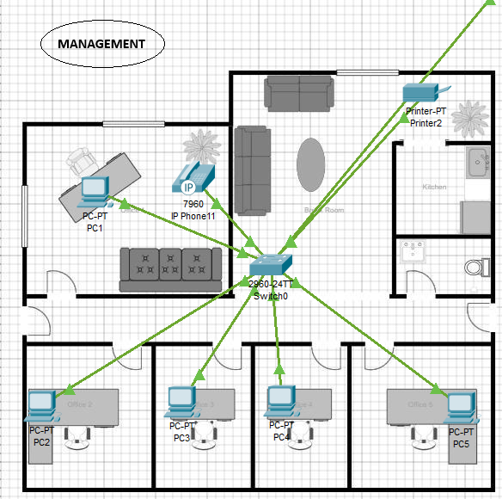
Part 1 - Network Diagram and Architecture
1. Introduction
The network architecture is structured into five distinct sectors: Management, Study, Production, Support 1, and Support 2. Each department is allocated its own VLAN to ensure traffic segmentation, preventing unauthorized lateral movement between departments and reducing the attack surface in case of a breach.
2. Key architectural components
Management VLAN: Responsible for administrative operations, housing 5 computers, a printer, and IP phone. Segmentation via VLAN isolates these from production sectors, minimizing risk

Slide 4
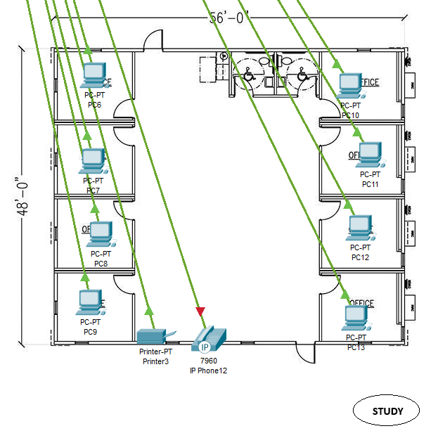
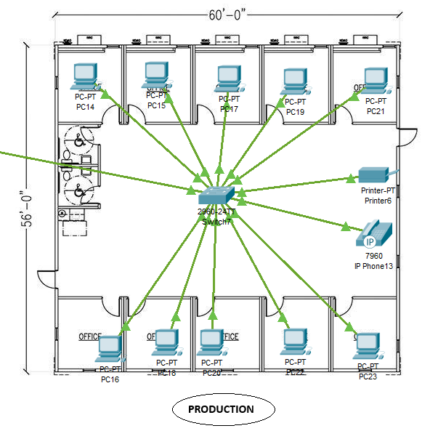
Study VLAN: Contains 8 computers and a printer, supporting research and study operations.
Production VLAN: Consists of 10 workstations and handles the core production tasks. Production areas have the highest number of computers, which is appropriate given their workload

Slide 5
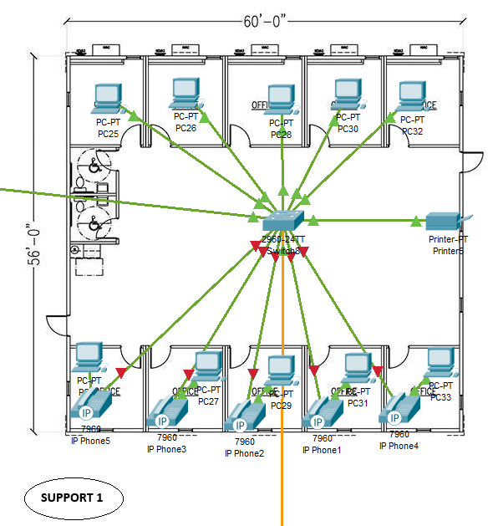
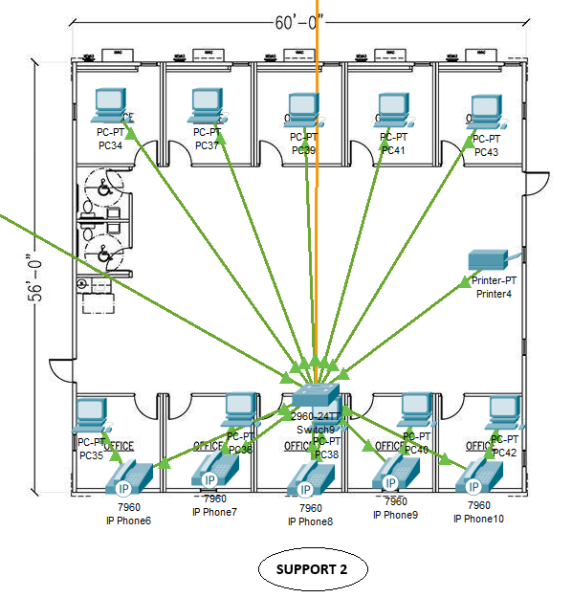
Support 1 and Support 2 VLANs: Each support sector contains 10 computers, supporting technical and customer service operations.

Slide 6
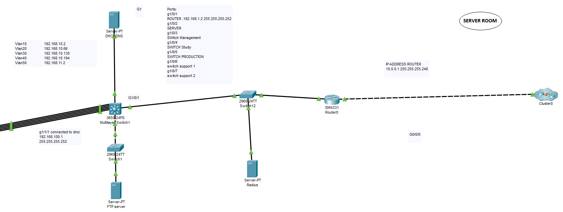
Server Room: 4 servers (DNS, DHCP, FTP, RADIUS), 2 routers, 1 multilayer switch, 1 switch. Centralizing servers and key devices is essential for security, organization, and access control.
By strategically placing switches and routing traffic via Layer 3 switches, we’ve ensured that the network is both scalable and efficient without requiring additional routing hardware.
3. Justification for Architecture:
VLAN Segmentation: Each department (Management, Study, Production, Support) is on a different VLAN, which ensures that sensitive data is isolated.
Layer 3 Switches: These handle inter-VLAN routing, which is more cost-effective than adding extra routers.
Centralized Servers: All of the processing is controlled in a central location
Scalability: The architecture is scalable, allowing new devices or sectors to be added with minimal reconfiguration.

Slide 7
Part 2 - IP Addressing Table and VLANs
The network uses a structured IP addressing schema to assign specific subnets to each department, ensuring efficient traffic management and reducing the risk of IP conflicts. Dynamic IP assignment is managed by a centralized DHCP server, which is configured with different scopes for each VLAN. This dynamic assignment simplifies network expansion and reduces manual configuration errors.
Management VLAN: Assigned to subnet ...
Study VLAN:
Production VLAN:
Support 1 VLAN:
Support 2 VLAN:
Inter-VLAN routing is handled by Layer 3 switches, ensuring seamless communication between departments while still maintaining traffic segmentation. Specific Access Control Lists (ACLs) further restrict unnecessary communication between certain VLANs, protecting sensitive resources like Management’s assets from being accessed by Production or Support sectors.

Slide 8
Part 3 - Device Configuration
Key network devices were configured with security and performance in mind, following best practices for a secure and maintainable network infrastructure:
Layer 3 Switches: These were configured to handle inter-VLAN routing. By routing traffic locally within the switches, we reduced the need for additional routers and improved traffic flow efficiency.
DHCP Server: Configured with multiple scopes, one per VLAN, the DHCP server dynamically assigns IP addresses to client machines, streamlining device configuration across the network.
DNS Server: Provides internal name resolution for resources, simplifying navigation for users by translating domain names to IP addresses within the private network.
RADIUS Authentication: Centralized authentication through the RADIUS server enforces strong user authentication policies for network device access, ensuring only authorized personnel can access critical systems like switches, routers, and servers.

Slide 9
Documentation:- Configuration Summary for SW-Management Device Overview: Hostname: SW-Management IOS Version: 15.0 Configuration Size: 2733 bytes Security Features: Service Password Encryption: Passwords are encrypted for added security. Enable Secret: An encrypted secret password is configured. Port Security: Enabled on all access ports to prevent unauthorized devices from connecting. Configured on interfaces FastEthernet0/1 to FastEthernet0/6 and FastEthernet0/24. Spanning Tree Protocol (STP): Mode: PVST (Per VLAN Spanning Tree). System ID extension is enabled. BPDU Guard is enabled on all access ports to protect against bridging loops.

Slide 10
Storm Control: Broadcast storm control set to 5% on all access ports to limit broadcast traffic. VLAN Configuration: VLANs Enabled: VLANs: 10 (Management), 20 (Production), 30 (Study), 40 (Support), 50 (Voice), 99 (Management/Trunk). Interface Configuration: Access Ports: FastEthernet0/1 to FastEthernet0/6: All configured to access VLAN 10 with port security. FastEthernet0/24: Configured for Voice VLAN 50. Trunk Ports: GigabitEthernet0/1: Configured as a trunk port for VLANs 10, 20, 30, 40, 50, and 99. Native VLAN is set to 99. GigabitEthernet0/2: Allowed VLANs: 10, 20, 30, 40, 50, 99, but currently shut down. Interface States: All unused interfaces (FastEthernet0/7 to FastEthernet0/23) are administratively shut down. Line Configuration: Console Access: Password secured. VTY Lines: Password secured with SSH transport enabled for secure remote access.

Slide 11
Part 4 - Security Measures
Security was a primary focus throughout the network design process, with several measures implemented to protect the network from both internal and external threats:
VLAN Segmentation: Each department is separated by VLAN, ensuring that sensitive information from departments like Management cannot be accessed by other departments like Production or Support. This segmentation reduces the attack surface and enhances overall network security. VLAN segmentation not only improves performance by reducing broadcast traffic but also provides security benefits. By isolating departments in different VLANs, we reduce the risk of lateral movement in case of a breach. For example, if malware infects a device in the Study VLAN, it cannot spread to other departments such as Management or Production. This is crucial for preventing the spread of internal phishing attacks or unauthorized data access.
Access Control Lists (ACLs): We have implemented strict ACLs on inter-VLAN traffic to control which devices can communicate across VLANs. For instance, Production VLAN traffic is blocked from accessing resources on the Management VLAN except for specific exceptions, such as print services. Access Control Lists (ACLs) are a critical security measure to prevent unauthorized traffic between VLANs. They help block IP spoofing by ensuring that only trusted devices can communicate between sectors. For example, we’ve implemented ACLs to block all SSH traffic to Management VLAN devices from untrusted IP ranges, thereby reducing the attack surface and preventing potential exploitation of management resources.
RADIUS Authentication: The RADIUS server centralizes authentication, requiring users to authenticate before accessing any critical network device. This minimizes the risk of compromised devices, enforces strong password policies, and provides centralized management of user credentials.

Slide 12
Strong Password Policies and Encryption: We enforce strong password policies across all network devices and enable encryption protocols to secure traffic where possible, especially on the servers handling DNS, DHCP, and user authentication. This ensures that even if credentials are compromised, brute force attacks are less likely to succeed. All sensitive data traffic between servers, such as DNS and DHCP requests, is secured using AES-256 encryption. Additionally, communication between devices and the RADIUS authentication server is secured with TLS/SSL protocols to ensure data privacy and integrity during transmission. This reduces the risk of man-in-the-middle attacks and ensures compliance with best practices for securing sensitive information in transit.
Monitoring and Logging: In addition to preventive security measures, real-time monitoring and logging are essential for detecting and responding to potential threats. A centralized Syslog server has been implemented to collect logs from critical network devices, allowing for real-time monitoring of network traffic and suspicious activity. Additionally, SNMP (Simple Network Management Protocol) is used to monitor network health and performance. Alerts are configured to notify administrators in case of unauthorized access attempts or abnormal traffic, providing an extra layer of defense against security breaches.

Slide 13
Part 5 - Cost Breakdown and Resource Allocation
1. Introduction
We selected hardware components that strike a balance between performance, scalability, and cost-efficiency. The goal was to ensure the network infrastructure is robust enough to meet the client’s needs without over-investing in unnecessarily high-end equipment. For example, we chose mid-range €600 PCs that are capable of handling day-to-day business tasks without being overly specialized. Similarly, the selection of network switches, routers, and servers reflects a thoughtful approach to balancing functionality and budget.
The following is a detailed breakdown of the costs per sector.
2. Assumptions for Unit Costs:
PC: €600 each
Printer: €300 each
IP Phone: €100 each
Switch: €400 each
Server: €2000
Router: €800
Multilayer Switch: €1500
Firewall/ACLs (optional): €1200 per unit or configuration

Slide 14
Management
5 PCs (instead of 5): 5 × €600 = €3000
1 Printer: €300
1 IP Phone: €100
1 Switch: €400 Total for Management: €3800
Study
8 PCs: 8 × €600 = €4800
1 Printer: €300
1 IP Phone: €100
1 Switch: €400 Total for Study: €5600
Server Room
3 Servers: 3 x €2000 = €6000
1 Router: €800
1 Multilayer Switch: €1500 Total for Server Room: €8300

Slide 15
Production
10 PCs: 10 × €600 = €6000
1 Printer: €300
1 IP Phone: €100
1 Switch: €400 Total for Production: €6800
Support 1
10 PCs: 10 × €600 = €6000
5 IP Phones: 5 × €100 = €500
1 Printer: €300
1 Switch: €400 Total for Support 1: €7200
Support 2
10 PCs: 10 × €600 = €6000
5 IP Phones: 5 × €100 = €500
1 Printer: €300
1 Switch: €400 Total for Support 2: €7200

Slide 16
Overall Cost Breakdown
Grand Total (without firewall/ACLs): €38,900
Adding firewall/ACL costs:
Physical Firewalls: €44,900
Virtual ACL configuration: €38,900 + €1200 = €40,100
Deploying physical firewalls at the perimeter of the network provides crucial protection against external threats such as denial-of-service (DoS) attacks. By inspecting and filtering incoming and outgoing traffic, these firewalls prevent malicious traffic from reaching the internal network, safeguarding critical infrastructure from external attacks. The cost of €1,200 per unit is justified by the enhanced security and peace of mind they offer, especially for sensitive operations conducted within the Management and Server Room VLANs.

Slide 17
IP Addressing Table and VLANs
Management VLAN | 10 192.168.10.0/26
Study VLAN | 20 192.168.10.64/26
Production VLAN | 30 192.168.10.128/26
Support VLAN | 40 192.168.10.192/26
Voice VLAN | 50 192.168.11.0/26
Native VLAN | 99
DHCP/DNS | 8.8.8.8/8
iSCSI storage server | 192.168.100.2/30
RADIUS Server | 10.0.0.3/29
MULTI Layer Switch | 10 192.168.10.2
Vlan20 | 192.168.10.66
Vlan30 | 192.168.10.130
Vlan40 | 192.168.10.194
Vlan50 | 192.168.11.2 G1/0/1: 10.0.0.2/30 G1/0/2: 8.8.8.1/8 G1/0/8: 192.100.1.1/30
Vlan 100 | 192.168.100.0/30
Router | G0/0/0: 10.0.0.1/30 G0/0/1: 200.100.0.1/24

Slide 18
Conclusion
The network design and implementation successfully address the client's requirements for a secure, efficient, and scalable infrastructure. By employing VLAN segmentation, inter-VLAN routing, structured IP addressing, and robust security measures, the design optimizes both performance and protection across key departments. The use of Layer 3 switches and virtualized servers achieves cost efficiency while maintaining flexibility for future expansion. At a total cost of €38,900, the solution balances budgetary constraints with advanced capabilities. The design was validated through simulation, ensuring readiness for deployment and scalability to meet future needs.

